Slide 1

Big Data Project – JOB survey Visualization
Group 7
Prudhvinath Reddy Katha
Bhanu Siva Kumar Kommana
Vaishnavi Valluri
Vikhita Ganta
Mounika Chennuboina

Slide 2
What is Big Data Visualization ?
Big Data visualization allows user to present large and complex data of almost any type in a graphical format allowing it easy to understand and interpret.
It enables various industries, to gain insights, identifying patterns, and making data driven decisions.
It enables decision makers to explore data sets to identify correlations or unexpected patterns.
Notes:
Big Data visualization is the practice of translating information into a visual context, such as a map or graph, to make data easier for the human brain to understand and pull insights from.
It also allows us with a very important tool to identify correlations and patterns that may not be easy to comprehend from the big data itself. This can allow users to make more informed decisions on the big data.
A lot of companies and institutions today are using machine learning to gather and collect massive amount of data which can be very slow to sort through and explain. With the advancement in computing power and resources, dv allows us to speed this up and present the information in ways that people can understand

Slide 3

Why big data visualization is important ?
Review large amounts of data
Spot trends
Identify correlations and unexpected relationships
Present the data to others
Notes:
Often times raw datasets may be tremendous in size and volume, like thousands of spreadsheets of information. This is very difficult for the human mind to comprehend because of its limitations.
For example, in case of businesses, dv can also help them identify which factors affect customer behavior; pinpoint areas that need to be improved or need more attention and predict sales volume.
We can present the data and make it accessible to more people

Slide 4
AIM
The main purpose of this big data project is to present the enormous data present into a simple graphical user interface. So, every one can easily understand data and guide through it.
Notes:
The primary objective of this project is that we want to develop an interactive user interface that can provide users with more insights into big data through visualization techniques. In our case we will be using a job survey dataset that has demographic information about different types of job, location and pay and our application should allow users to easily identify emerging trends and patterns from the visualization.

Slide 5
Overview
The user visits the web page and attempts to generate various visualizations to gain insights by performing various mouse operations based on requirement or interest.
The visualization must update as the user specifies the requirements based on the mouse operations performed.
Various insights can be obtained based on interests. This information is presented to the user using a visual interface.
Notes:
Next, we come to the task overview for our project. This is to show you an overview of what exactly we want to achieve through our data visualization project. For various applications, users might want to generate a visualization from the raw dataset on webpage to gain a better understanding of the big data. We want to facilitate that by performing mouse operations on the webpage. Based on what input we get from the mouse operation, the generated visualization must update the user specifications accordingly. Finally, the information from the dataset in the webpage will be presented using a visual interface and displayed to the user. Through the visual interface, the user will be able to get valuable insights into the big data that may not have been possible just through raw datasets.

Slide 6
Challenges
The real challenge is making the interactions and operations user friendly, the user is not required to have a programming skill in order to gain insight from the visualization.
The interface should have simple mouse interactions that makes the job easier for user to gain insight.
We have programmed our code in Microsoft Visual Studio using the D3 JavaScript library to perform visualization from dataset and it is loaded into server using FileZilla.
Notes:
Now, obviously there are some challenges for our project that we had to work on. The main challenge in this project is to make interactions with the user interface as user friendly as possible. We don’t want this to be helpful or accessible only to people with a lot of programming or coding background, it should be able to be used by anyone.
Often times a mouse interaction with the user interface is the easiest way to interact and we should be able to easily gain insight and important information from the dataset in a simple manner.
To implement our project, we have used MVS to program our code MVS has a lot of tools and services that make development easy.
We use D3 a JavaScript library for producing dynamic, interactive data visualizations using web standards. It can be used for manipulating documents based on data.
For loading our dataset into server, we use FileZilla which is basically a free and open-source, cross-platform FTP application, consisting of FileZilla Client and FileZilla Server

Slide 7
GUI Design
Generally, majority of the visualization interface are command line interface.
In this the interface has simple mouse interactions that makes the job easier for user to gain insight.

Slide 8
Tableau
Data Connectivity
Visualization Capabilities
Interactivity
Advanced Analytics
Easy to Use
Notes:
Tableau is a powerful data visualization software that enables users to create interactive and shareable dashboards and visualizations from various data sources. It is widely used across industries for its user-friendly interface and robust features.

Slide 9
Experimental Evaluation
Dataset:
We have considered job survey dataset for performing visualization.
Identifying visualization tasks for the dataset:
Identify the variety of jobs and their income.
Find the average salary amount for particular role in particular place.
Identify the annual income with respect to the place.
Notes:
To perform visualizations based on the job survey dataset and accomplish the identified tasks effectively, you can utilize various visualization techniques and charts

Slide 10
Experimental Evaluation
Design for the visualization system to fulfill the identified tasks:
We have considered pie chart for representing the total companies by size and location, experience level, and employment type.
We have considered bar chart for representing the employee residencies and average salary by experience level.
We have considered showing world plot for identifying the average salary by country average income. For this visualization we choose two parameters Income and place to identify the average salary.

Slide 11
Experimental Evaluation
Interactions used in this visualization:
Filtering:
Filtering is one of most common ways of focusing on specific information within a graphic.
Zooming:
Zooming is the capacity to look for and focus on interesting areas within the graphic.
Labeling :
Labeling is process of associating visualization with data. It is used to explain the visualization, data and relationships.
Notes:
Filtering allows users to focus on specific information of interest by temporarily excluding irrelevant data. This helps in exploring trends, patterns, or outliers within the dataset more effectively.
Zooming is particularly useful for large or detailed visualizations where users may want to explore specific sections or data points in greater detail without overwhelming the entire display.
Labeling enhances the understanding of the visualization by associating visual elements with specific data or information. It helps users interpret the visualization more accurately.

Slide 12
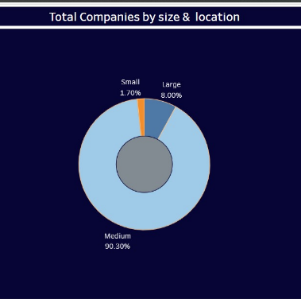
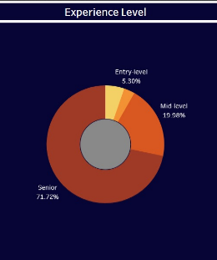
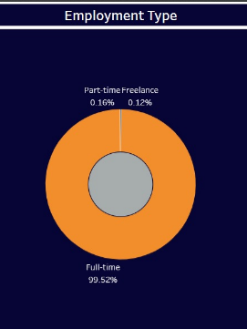
Results
Notes:
The first pie chart represents the variety of companies according to size and location.
The second pie chart represents the experience level in their field and the third pie chart represents the employment type
User has options to view the chain of the job according to the income, location, size, type that perform interactions on the visualization.
The user can see the chain which is dividing the circle into proportional segments with the income of each chain.

Slide 13
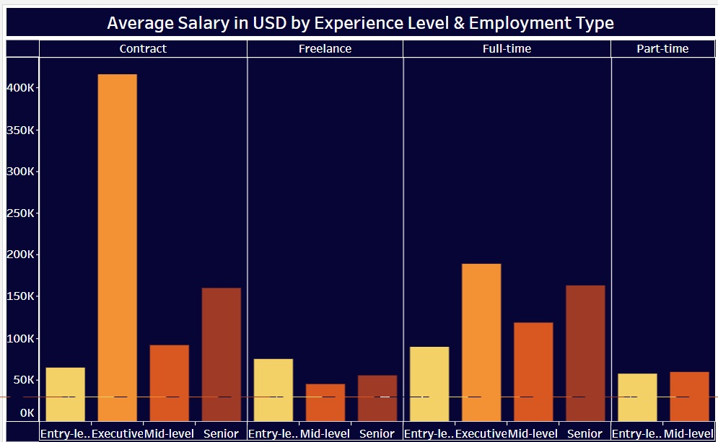
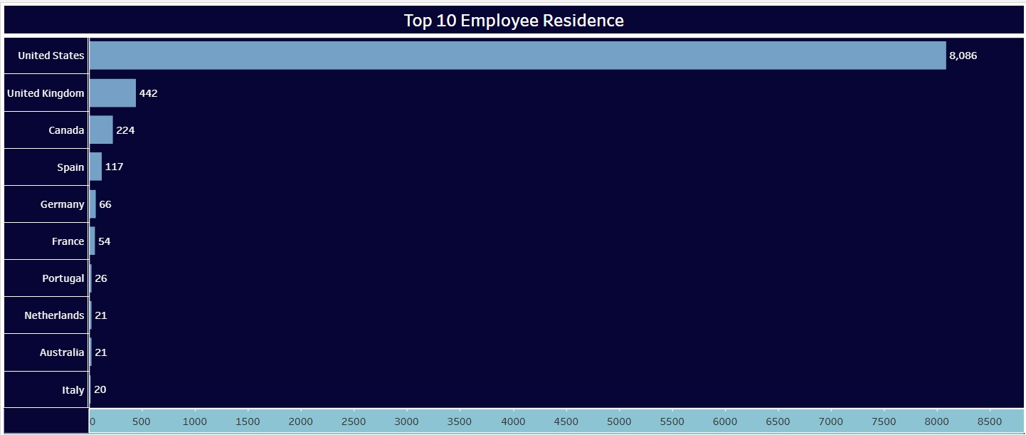
Results
Notes:
The bar graph represents the top 10 employee residence where most of the employees live and the second chart represents average salary in usd by experience level and employment type.

Slide 14
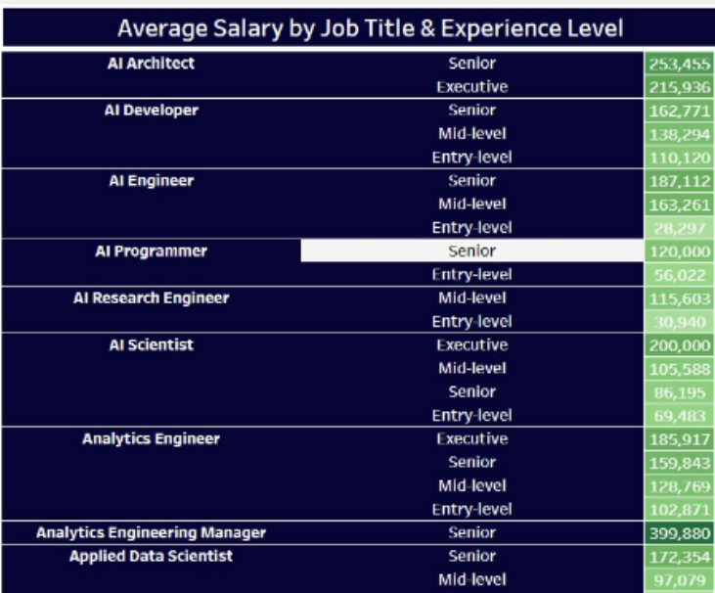
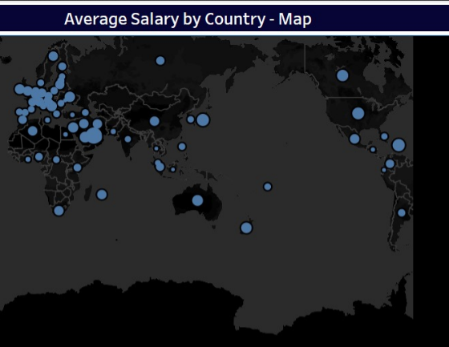
Results

Slide 15
Future work
Most of the interface is user friendly but its little complicated to understand at first this can be improved by better instructions attached to application.
The project's long-term focus is to generate more visualizations and use larger datasets. This can be achieved by using d3.js libraries to compose dynamic visualizations based on user requirements.

Slide 16
THANK YOU

